Slide 1
Chilliwack Secondary
We acknowledge that Chilliwack Secondary is situated on the Stó: lō, Sq’éwlets, and Sts’ailes peoples, particularly the Aitchelitz, Cheam, Kwaw kwaw apilt, Shxwha:y, Skowkale, Skwah, Soowahlie, Squiala, Tzeachten and Yakweakwioose First Nations. The traditional gathering place for many Indigenous people. We honor and respect the history, language, ceremonies, and culture of the First Nations who call this territory home. To acknowledge this traditional territory is to recognize its longer history, one predating the establishment of the earliest European colonies.
The First People’s connection to the land teaches us about our inherent responsibility to the land and sea and to respect Mother Earth. With this acknowledgment, we honor the ancestors and children who have been buried here, missing, and murdered Indigenous women and men, and the ongoing collective healing for all human beings. We are reminded that we are all treaty people and of the responsibility we have to each other.

Slide 2
Financial Awards
Chilliwack Secondary

Slide 3
WHO CAN APPLY?
Gr 12 SD 33 graduating students that are planning to go to any post-secondary institute within 2 years.

Slide 4
WHAT ARE THEY?
Money that goes towards Post-Secondary education/training that has been donated by community clubs, organizations, provincial government, private business.

Slide 5
WHERE DO I APPLY?
Go to: css.sd33.bc.ca/financial-awards
Read the Lists
Fill out application form(s)
Do attachments/Upload in MS Teams

Slide 6
WHEN ARE THEY DUE?
Internals – February 5-8
Externals –February 19-22
District Auth – April 11th

Slide 7
WHY DO THIS?
Help pay for your College/University/Trade Program
Last year over $400,000 was Awarded to CSS students

Slide 8
Css.sd33.bc.ca

Slide 9
Step By Step guide with links in orange type

Slide 10
Provincial Scholarships

Slide 11
District Authority Awards
Due April 11th

Slide 12
On-line Scholarships

Slide 13
Post-Secondary Scholarships

Slide 14
SD33 Financial Awards

Slide 15
Agreement Form

Slide 16
10 Things That Students Need To Know About Post-Secondary

Slide 17
Internal Awards

Slide 18
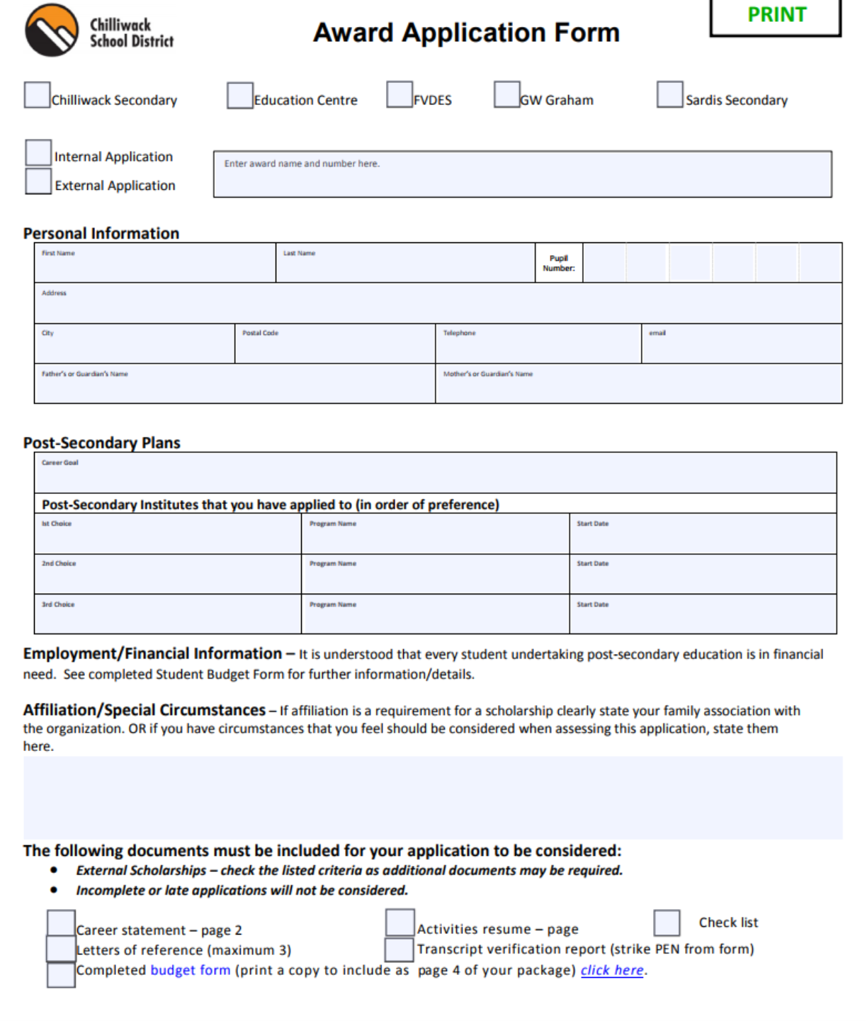

Slide 19
Award Criteria
GPA or grade point average
School involvement -sports, theatre, band, clubs, WEX, Leadership
Community involvement -youth groups, sports teams, dance programs, CSOPA
Volunteer –Lions Club, Reapers, Reading buddies
Affiliations -Glenayre Realty, Teacher Association
Special Affiliations-Aboriginal, Youth in Care, Adversity, Hearing and Visual impairment, Disabilities
Athletics participation, Independent and Team sports, coaching and refereeing

Slide 20
What can students be doing now?
Sign the Agreement Form and email to Mrs Soltys
Financial Awards resume for your References
Letters of Reference
Career Statement
Volunteering in school/community
Attend Workshops
Career planning with myblue print/education planner
Make an appointment with me

Slide 21
3 EASY STEPS
Go to http://css.sd33.bc.ca
Complete the application form
Upload during due date time

Slide 22
Workshops
November 8th &22nd, December 6th, January 10th &24th,31st. Lunchtime in the Library

Slide 23
Upcoming Events
UBC Field Trip Oct 19th
Post Secondary Event Open House 11-12 Mini gym
Education Planner for Parents. Tuesday, November 7,2023 6:30 – 8:00 p.m. MS Teams
UFV Open House Oct 21st
Explore UVIC Field Trip Nov 25th

Slide 24
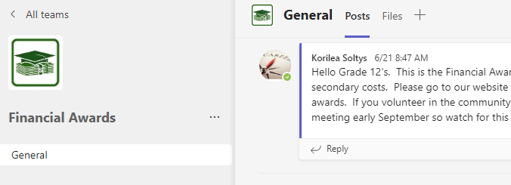
Up to date Information
604-795-6892 text only

